Slide 1



ENHANCED SECURITY FRAMEWORK FOR GRAY-HOLE ATTACK PREVENTION IN VEHICULAR NETWORKS
18ECP107L
BATCH :22
FINAL REVIEW
PRESENTED BY:
MIDHUN R (927621BEC120)
KAVINESH A S (927621BEC081) KARVENDAN P (927621BEC077) KISHORE K (927621BEC094)
GUIDED BY:
Dr. S. VIMALNATH, B.E.,M.E.,Ph.D.,
ASSOCIATE PROFESSOR /ECE

Slide 2
ABSTRACT
This research proposes an innovative and efficient approach for the detection and prevention of Gray-Hole attacks in Vehicular Ad Hoc Networks (VANETs). Gray-Hole attacks pose a significant threat to the reliability and security of VANETs.
Our approach employs a combination of anomaly detection techniques and dynamic trust management to identify suspicious nodes exhibiting abnormal behavior indicative of Gray-Hole attacks.
Upon detection, a proactive prevention mechanism is triggered to isolate and mitigate the impact of compromised nodes.

Slide 3
INTRODUCTION
Vehicular Ad Hoc Networks (VANETs) support vehicle-to-vehicle communication to improve road safety and traffic management in intelligent transportation systems.
Due to the dynamic and decentralized nature of VANETs, they are highly vulnerable to Gray-Hole attacks where malicious nodes selectively drop or alter data packets.
Addressing such threats requires an effective detection and prevention system to maintain the reliability, safety, and trust of vehicular communication networks.

Slide 4
LITERATURE REVIEW
S.NO | Author(s) | Title & Name of the Journal | Year | Remarks
1. | Abdul Malik , Muhammad Zahid Khan , Mohammad Faisal | An Efficient Dynamic Solution for the Detection and Prevention of Black Hole Attack in VANETs | 2021 | Resource Overhead Adaptability to Evolving Threats
2. | POOJA RANI , KAVITA | Mitigation of Black Hole and Gray Hole Attack Using Swarm Inspired Algorithm With Artificial Neural Network | 2020 | real-world deployment could pose challenges related to hardware compatibility, energy efficiency, and robustness in dynamic and unpredictable MANET environments.

Slide 5
S.NO | Author(s) | Title & Name of the Journal | Year | Remarks
3. | Ankit Kumar , Vijayakumar Varadarajan | Black hole attack detection in vehicular ad-hoc network using secure AODV routing algorithm | 2021 | As the number of vehicles and network nodes increases, the overhead associated with the modified protocol may become prohibitive, affecting scalability and overall network performance.
4. | Shamim Younas 1,Faisal Rehman | Collaborative Detection of Black Hole and Gray Hole Attacks for Secure Data Communication in VANETs | 2022 | This increased complexity could impact the real-time performance and responsiveness of the system, which is critical for ensuring the safety of autonomous and connected vehicles.

Slide 6
S.NO | Author(s) | Title & Name of the Journal | Year | Remarks
5. | Tushar Pokar1, Prof. Shreya Patel2 & Prof. Rakesh Shah | An Efficient Approach Of Dsr Protocol To Detect And Prevent Black Hole Attack For Vanet | 2019 | Managing communication and coordination among a large number of vehicles and street-side units can become increasingly challenging and may impact the scalability of the system.
6. | Gurtej Kaur, Meenu Khurana, Amandeep Kaur | Gray Hole Attack Detection and Prevention System in Vehicular Ad- Hoc Network (VANET) | 2021 | Limited Scope

Slide 7
EXISTING SYSTEM
In the current landscape of Vehicular Ad Hoc Networks (VANETs), security remains a
critical concern due to the susceptibility to various attacks, including the Gray-Hole threat.
Existing systems often rely on conventional security mechanisms, such as encryption and authentication, to safeguard communication channels.
These methods may fall short in detecting and preventing sophisticated attacks like Gray- Hole, which involve nodes selectively manipulating or dropping packets without overtly violating encryption or authentication protocols.

Slide 8
PROBLEM STATEMENT
Gray-Hole attacks are dangerous because they secretly drop or change data packets in vehicle networks, making them hard to find.
Old security methods like encryption can't detect this sneaky behavior effectively.
We need a smart and fast system that can find and stop these attacks while the network is running.
These attacks can affect important safety tasks, like avoiding accidents, sending emergency messages, and managing traffic.

Slide 9
OBJECTIVE
The primary objective of this research is to develop a robust solution for the detection and prevention of Gray-Hole attacks in Vehicular Ad Hoc Networks (VANETs).
Gray-Hole attacks pose a severe threat to the integrity of communication in VANETs by selectively manipulating or dropping data packets.
This research aims to enhance the security and reliability of VANETs by employing innovative anomaly detection techniques and dynamic trust management mechanisms.

Slide 10
PROPOSED METHODOLOGY
The system uses a combined approach with encryption, trust checks, and behavior monitoring to detect gray-hole attacks.
Secure communication is set up first using cryptographic methods to keep data safe and private.
A trust system checks if vehicles behave properly based on their past actions.
Anomaly detection tools watch traffic closely and catch any strange behavior that may signal an attack.

Slide 11
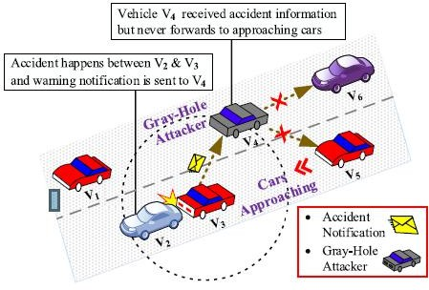

Slide 12

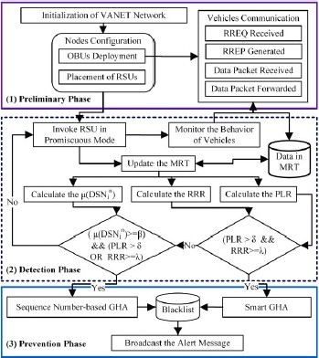
BLOCK DIAGRAM

Slide 13
PROPOSED METHODOLOGY EXPLANATION
The proposed DPGHA is presented in detail The overall system design framework of the proposed DPGHA, its components, and operations are illustrated.
It consists of three main phases: the preliminary phase, the detection phase, and the prevention phase.
Each phase has different operations and functionalities integrated to achieve security against GHA in VANET.
we explain the preliminary phase, which contains the underlying system model of VANET, the node properties, the communication paradigm, the placement of RSUs, and some assumptions.

Slide 14
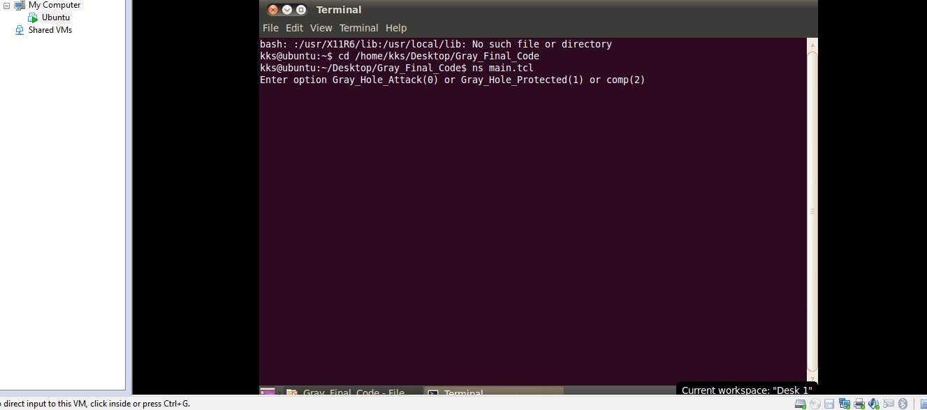
SIMULATION RESULT ON NS2 TOOL

Slide 15
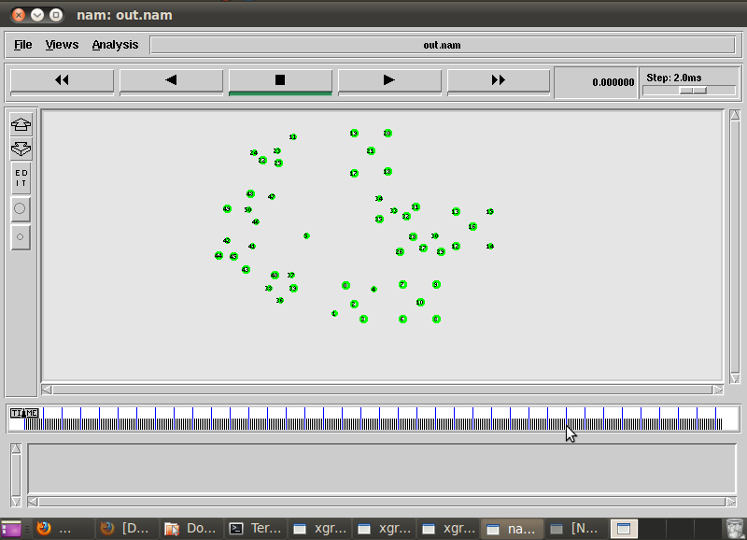
NODE CREATION

Slide 16
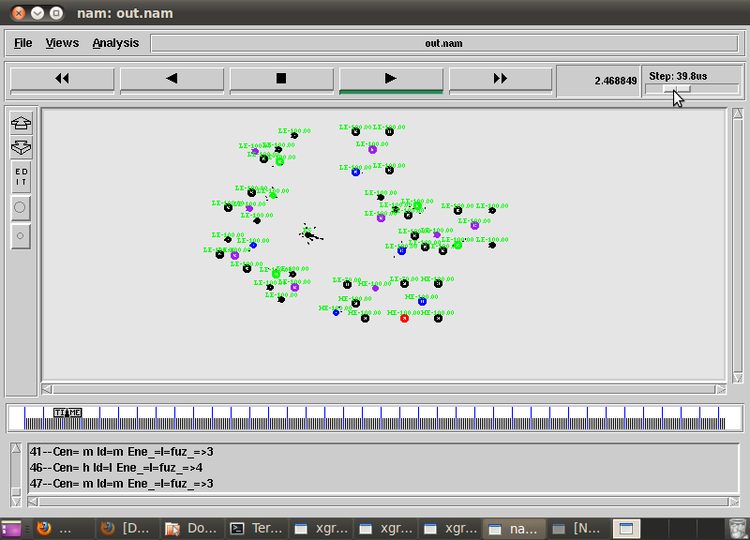
GRAY HOLE ATTACKER PRESENT

Slide 17
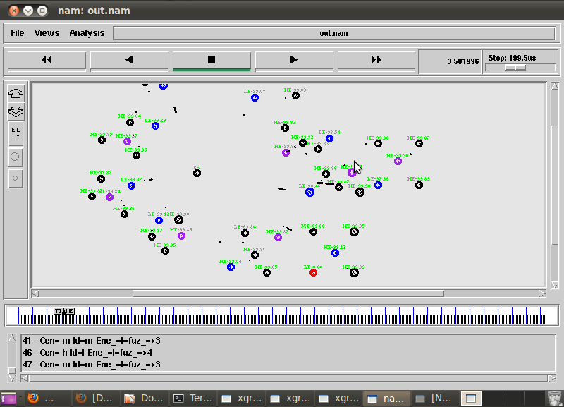
DETECTION GRAY WHOLE ATTACKER

Slide 18

DATA COMMUNICATION

Slide 19
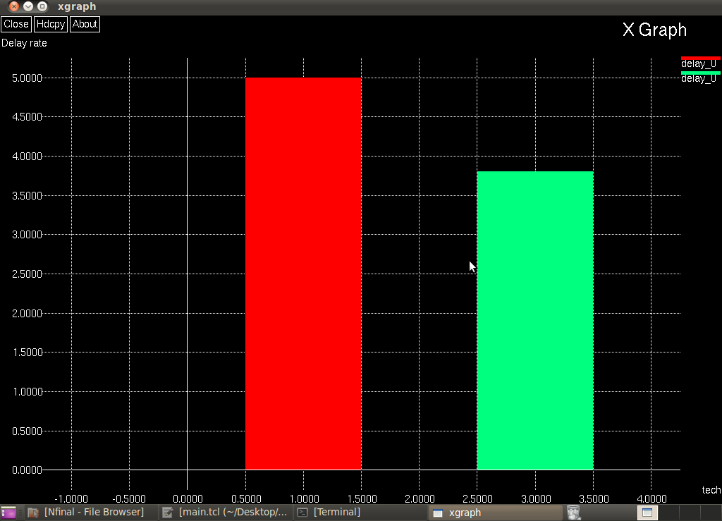
DELAY COMPARISON

Slide 20
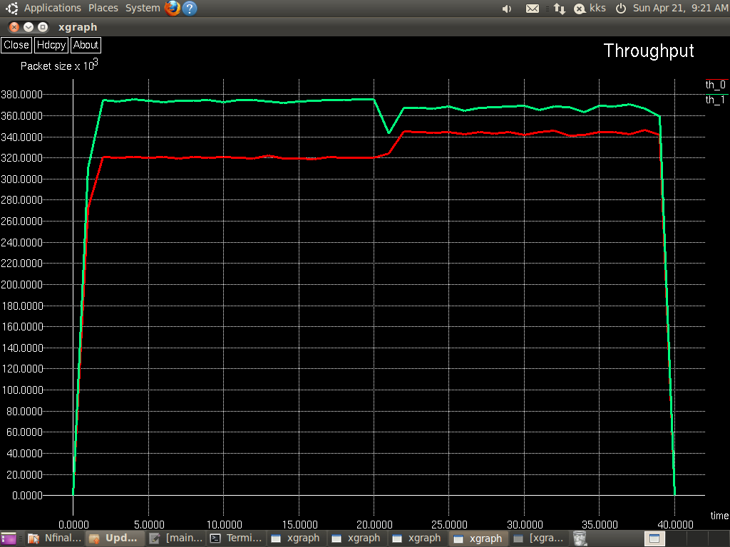
THROUGHPUT RESLUT

Slide 21

ADVANTAGES
Dynamic Reputation Management
The system continuously monitors and updates the reputation of vehicles.
Enhanced Detection Accuracy
The framework uses advanced algorithms to detect malicious activities more accurately.
Reduced Routing Overhead
Instead of frequent re-routing, it maintains secure
and efficient communication.

Slide 22
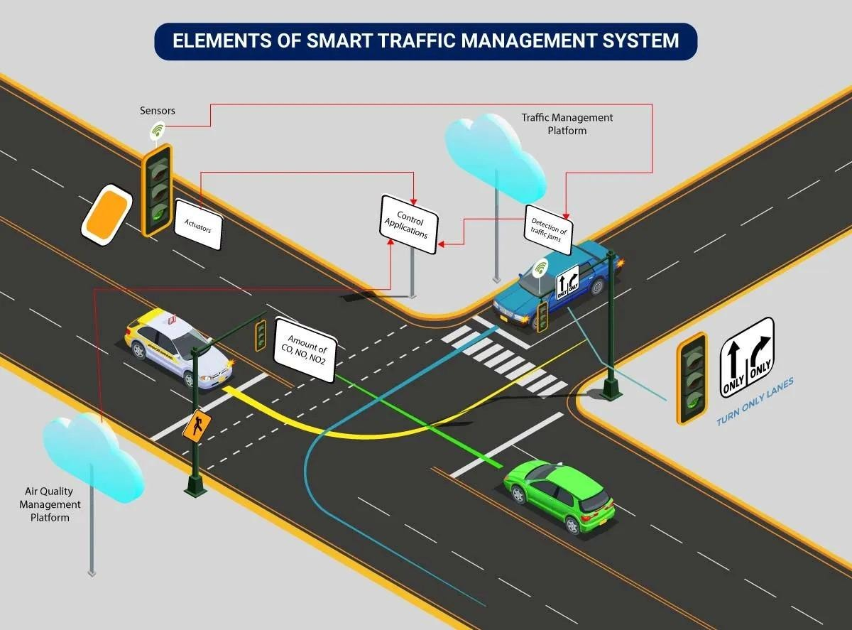
APPLICATIONS
Traffic Safety and Accident Prevention
Reduces risks of accidents caused by delayed or missing communication.
Smart Traffic Management
Enhances routing efficiency by ensuring accurate
traffic data sharing.
Emergency Response Systems
Prevents malicious interference in life-critical
communication.

Slide 23
CONCLUSION
Effective Detection and Prevention
The proposed system successfully detects and prevents Gray-Hole attacks in VANETs using a combination of anomaly detection and dynamic trust management.
Improved Network Performance
Simulation results in NS-2 show better packet delivery, network reliability, and overall security, even during attacks.
Future Scope
The approach can be extended to handle other types of attacks and enhanced
further using machine learning for more accurate threat detection.

Slide 24
REFERENCE
Rasheed Hussain, Fatima Hussain, Sherali Zeadally “Integration of VANET and 5G Security: A review of design and implementation issues” Elsevier Future Generation Computer Systems (Volume 101, December 2019).
Xiaobo Wang; Yu Weng; Honghao Gao “A Low-Latency and Energy-Efficient Multimeric Routing Protocol Based on Network Connectivity in VANET Communication” IEEE Transactions on Green Communications and Networking (Volume: 5, Issue: 4, December 2021).
Maryam Gillani, Hafiz Adnan Niaz, Muhammad Umar Farooq, Ata Ullah “Data collection protocols for
VANETs: a survey” Springer Nature - Complex & Intelligent Systems (Volume 8, January 2022).
S Vimalnath, G Ravi (2020) “Optimized Geographic Routing in Mobile Ad Hoc Network using Bees Swarm Optimization”, Journal of Scientific & Industrial Research, Publishe: NISCAIR-CSI,Vol. 79, pp. 727-729.

Slide 25
Abdul Malik, Muhammad Zahid Khan, Saeed Mian Qaisar, Mohammad Faisal, Gulzar Mehmood “An Efficient Approach for the Detection and Prevention of Gray-Hole Attacks in VANETs” IEEE Access (Volume: 11, 09 May 2023).
Pooja Rani, Kavita, Sahil Verma, Gia Nhu Nguyen “Mitigation of Black Hole and Gray Hole Attack Using Swarm Inspired Algorithm with Artificial Neural Network” IEEE Access (Volume: 8, 25 June 2020).
Vimalnath. S, Ravi. G., (2020). “Optimized Geographic Routing in Mobile Ad Hoc Network Using
Gray Wolf Optimization,” EAI endorsed transaction. (Research Article-EAI.EU).
Ansam Khraisat, Iqbal Gondal, Peter Vamplew, Joarder Kamruzzaman “Survey of intrusion detection systems: techniques, datasets and challenges” Springer Nature - Cybersecurity (Volume 2, article number 20, July 2019).

Slide 26
Dr. T. Ananth Kumar1, A. Devi1, N. Padmapriya, S. Jayalakshmi1, P. Divya “A Survey on Advance Black/Grey hole Detection and Prevention Techniques in DSR & AODV Protocols” International Journal on Wireless, Networking & Mobile Communication Innovations (Volume 5, Issue 1 – 2021) ISSN: 2581-5113.
Jeong-Kyu Bae, Myung-Chul Park, Eun-Ju Yang; Dae-Wha Seo “Implementation and Performance Evaluation for DSRC-Based Vehicular Communication System” IEEE Access (Volume: 9, 14 December 2020).
Gurtej Kaur, Meenu Khurana, Amandeep Kaur “VANET Cluster Based Gray Hole Attack Detection and Prevention” Springer Nature – Computer Science (Volume 5, article number 186, January 2024).

Slide 27
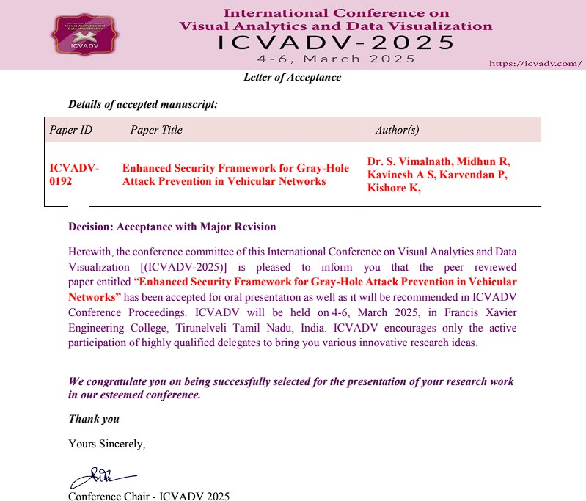
PROJECT OUTCOME STATUS AS ON DATE DETAILS (PROOF)

Slide 28

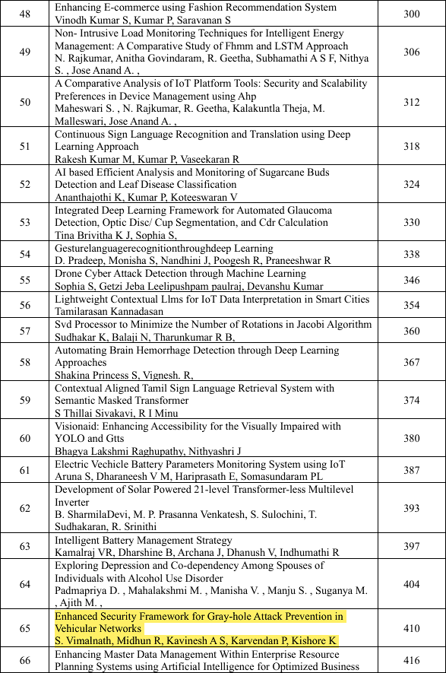

Slide 29


